Slide 1
CSE322
The Chomsky Hierarchy
Lecture #16

Slide 2
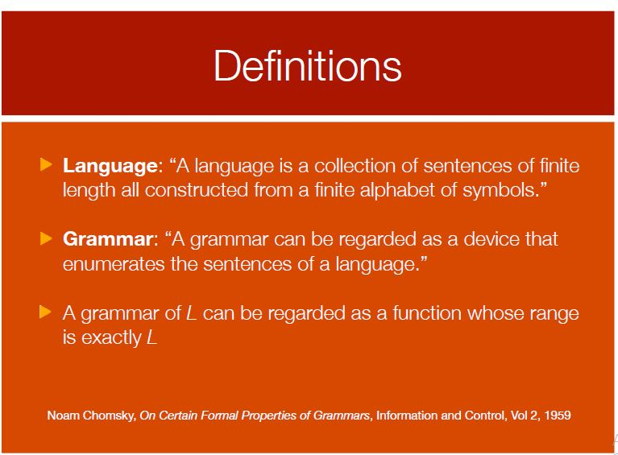

Slide 3

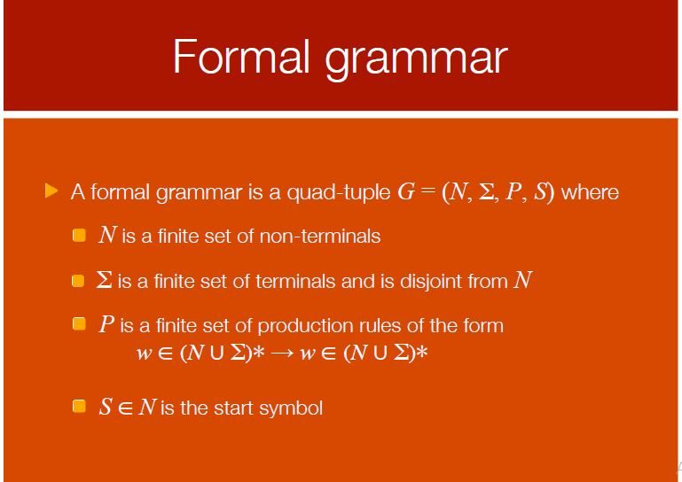

Slide 4
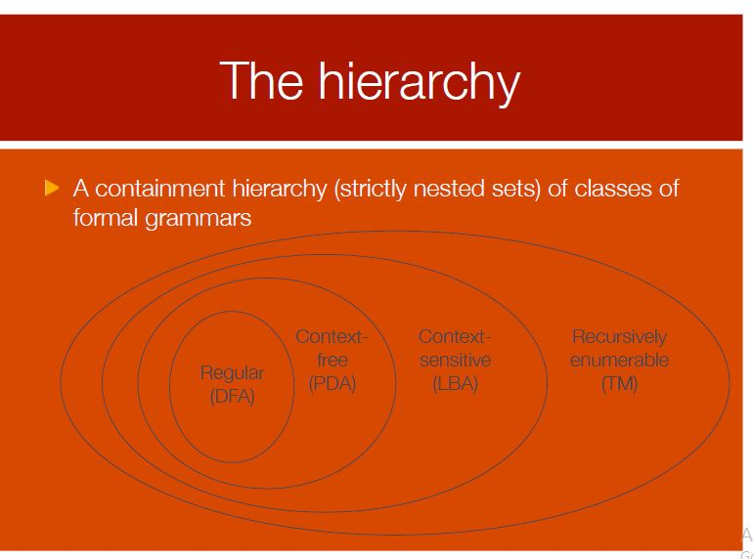

Slide 5
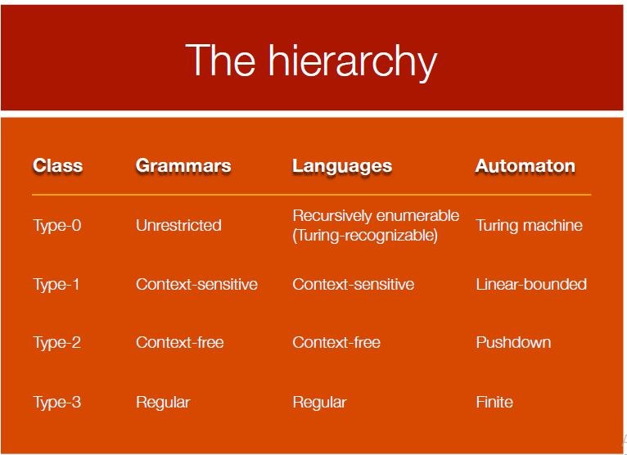

Slide 6
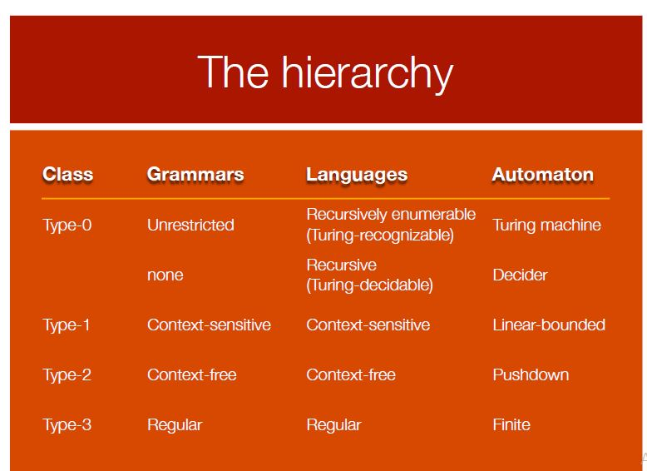

Slide 7
Applications of Automata
TM- Real Life Implementation ,Software Implementation
LBA- Generic Programming, Parse Trees
PDA-Online Tracking processing system,Top Down Parsing in LL Grammer
FA-Finite State Programming,UML State Diagrams, Acceptors and Recoganizers, Lexical Analyzer

Slide 8
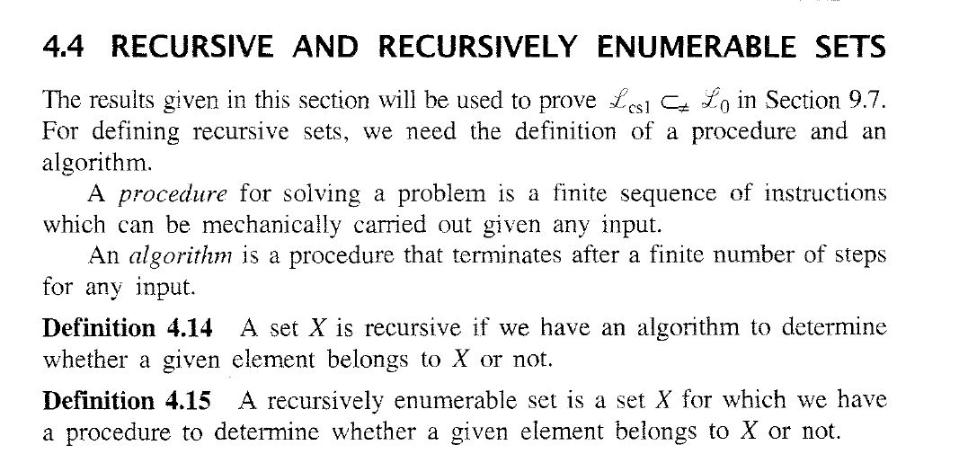
Recursive and Enumerable Sets

Slide 9
Linear-Bounded Automata:
Same as Turing Machines with one difference:
the input string tape space
is the only tape space allowed to use

Slide 10







Linear Bounded Automaton (LBA)
Input string
Working space
in tape
Left-end
marker
Right-end
marker
All computation is done between end markers

Slide 11
We define LBA’s as NonDeterministic
Open Problem:
NonDeterministic LBA’s
have same power as
Deterministic LBA’s ?

Slide 12
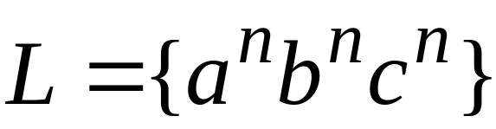
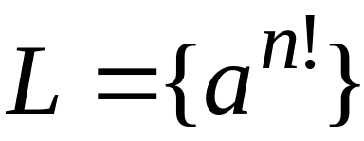
Example languages accepted by LBAs:
LBA’s have more power than PDA’s
(pushdown automata)
LBA’s have less power than Turing Machines

Slide 13

Unrestricted Grammars:
Productions
String of variables
and terminals
String of variables
and terminals

Slide 14
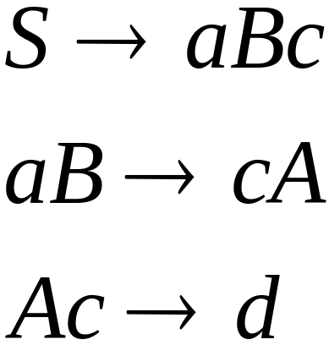
Example unrestricted grammar:

Slide 15

Theorem:
A language is Turing-Acceptable
if and only if is generated by an
unrestricted grammar

Slide 16
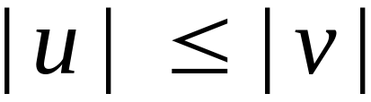
Context-Sensitive Grammars:
Productions
String of variables
and terminals
String of variables
and terminals
and:

Slide 17
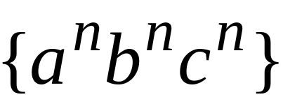
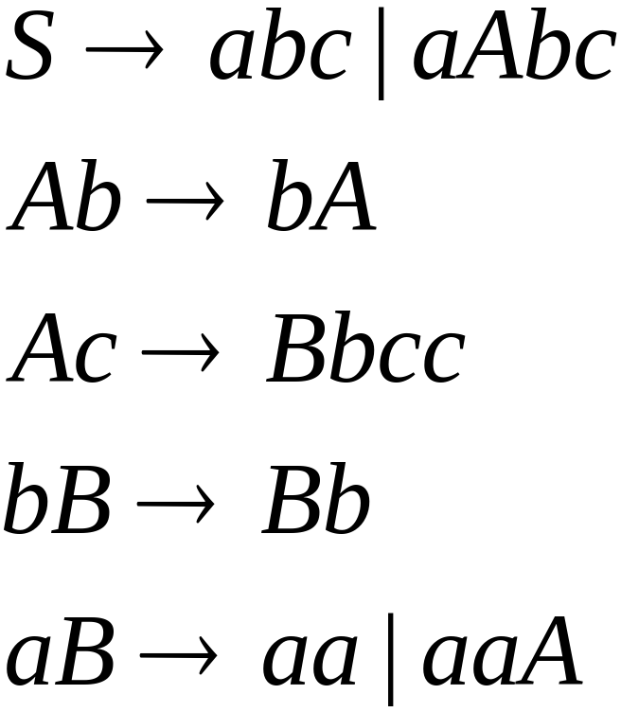
The language
is context-sensitive:

Slide 18
Theorem:
A language is context sensistive
if and only if
it is accepted by a Linear-Bounded automaton
Observation:
There is a language which is context-sensitive
but not decidable

Slide 19
The Chomsky Hierarchy
Non Turing-Acceptable
Turing-Acceptable
decidable
Context-sensitive
Context-free
Regular

Slide 20
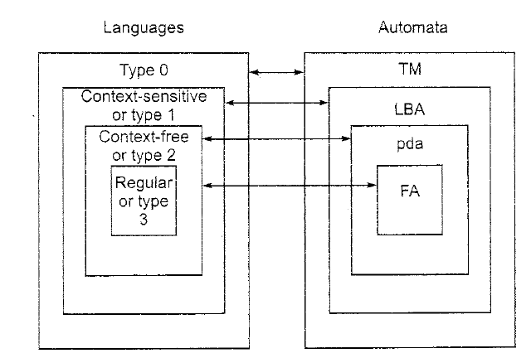
LANGUAGES AND AUTOMATON
Notes:
The Chomsky Hierarchy

Slide 21
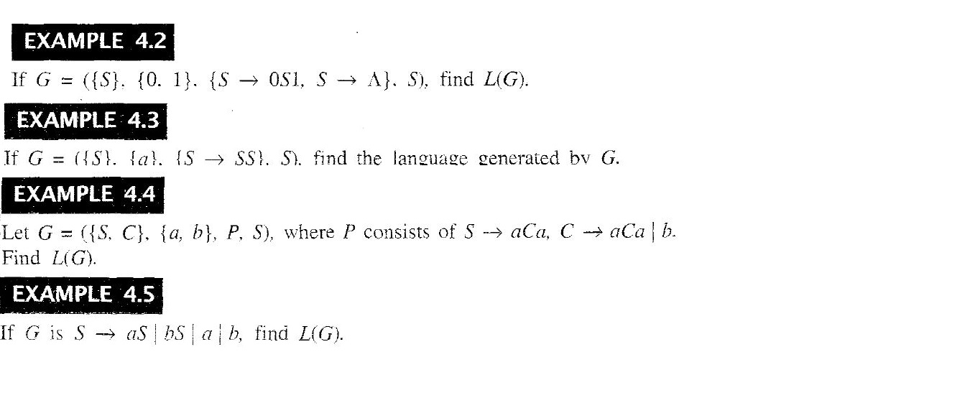
Questions

Slide 22
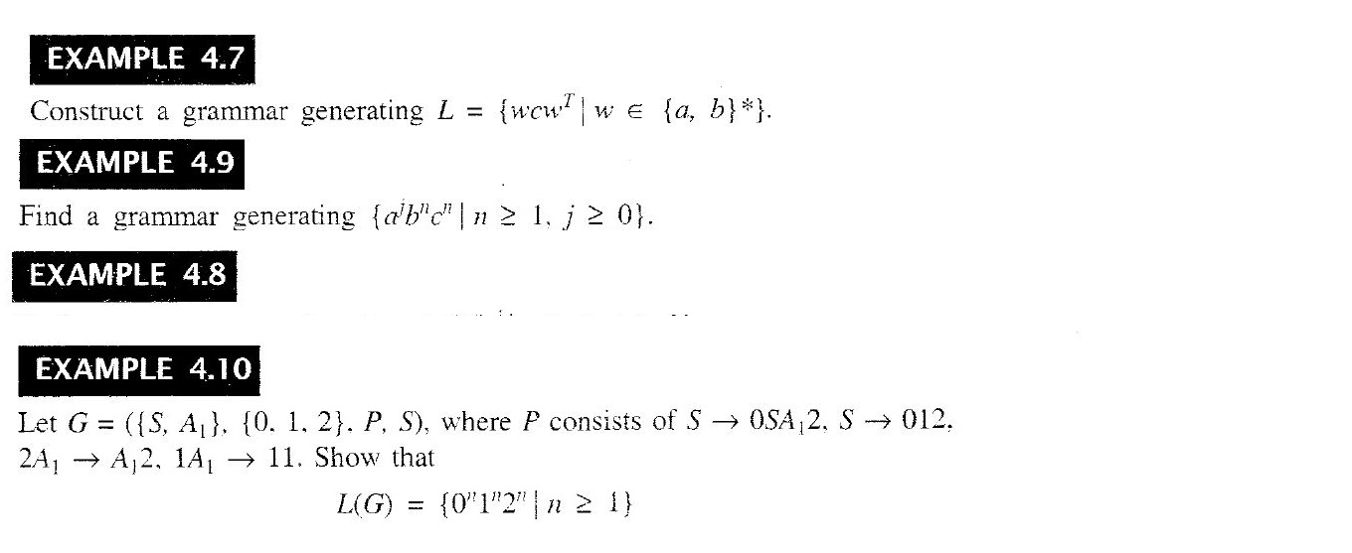

Slide 23

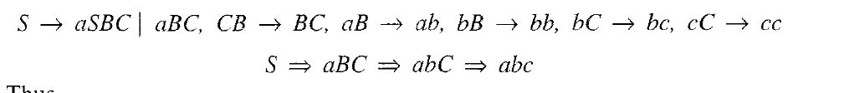
Prove it as

Slide 24
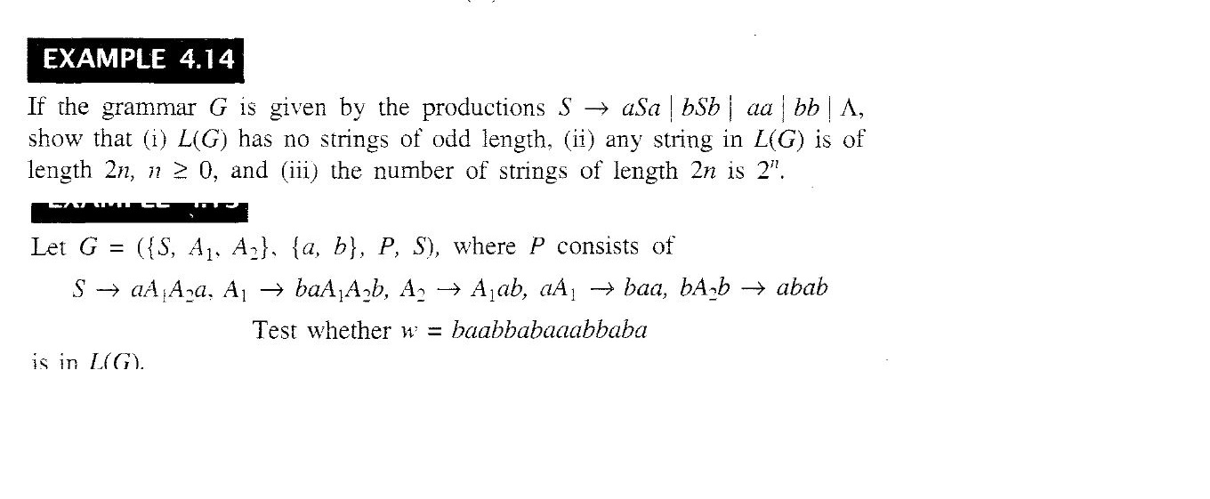

Slide 25
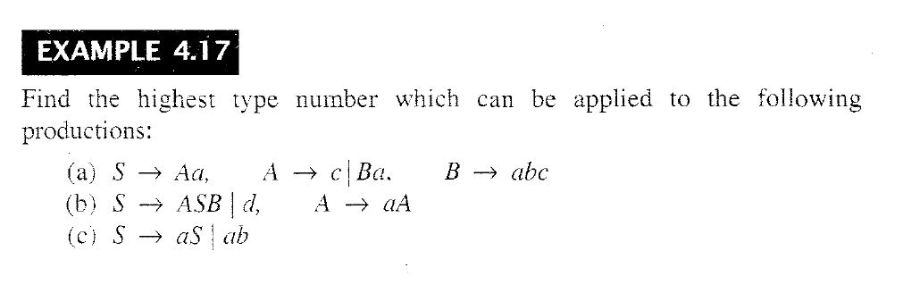

Slide 26
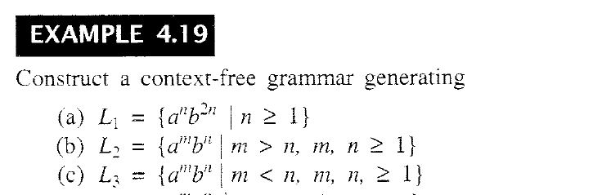

Slide 27
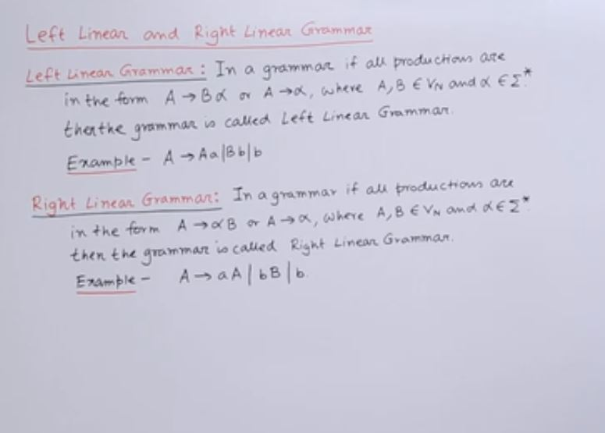
Left Linear Grammer vs Right Linear Grammer

Slide 28
Left Linear Grammer vs Right Linear Grammer
Regular language works on right linear
Whereas CFG and CSG can work on left linear

